Slide 1
Bonferroni Correction/Adjustment
Math 699: Design and Analysis of Experiments
Spring 2018
Kevin Rodriguez

Slide 2
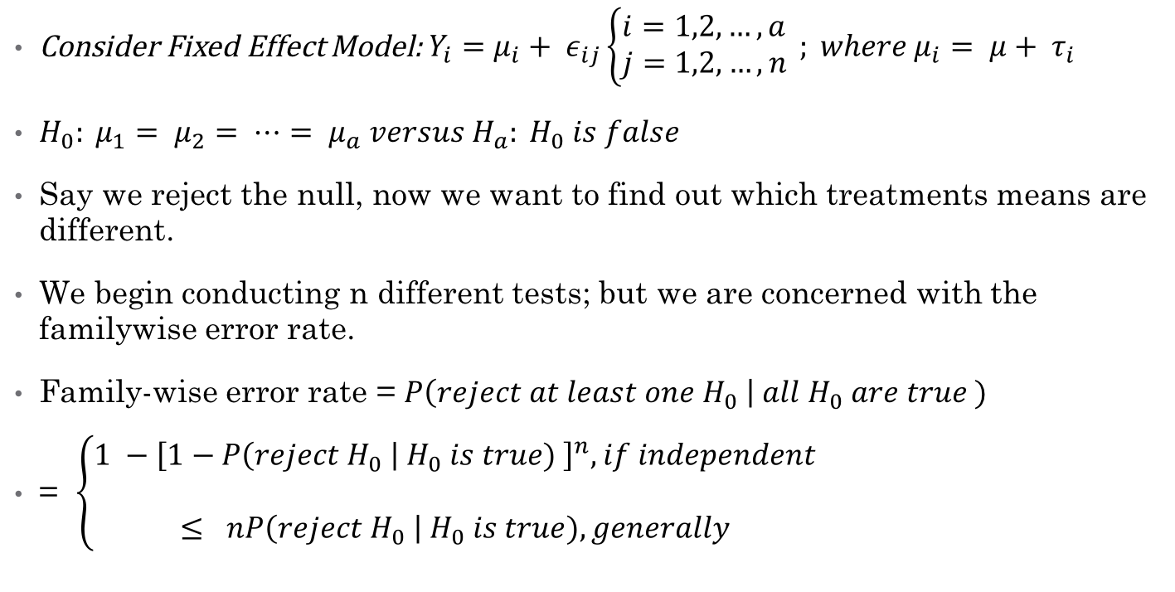
Multiple Comparisons
Consider Fixed Effect Model: $Y_{i}=μ_{i}+ ε_{ij}\left\{\begin{aligned}i=1,2,…, a \\ j=1,2,…,n\end{aligned}\right. ; where μ_{i}= μ+ τ_{i}$
$H_{0}: μ_{1}= μ_{2}= ⋯= μ_{a} versus H_{a}: H_{0} is false$
Say we reject the null, now we want to find out which treatments means are different.
We begin conducting n different tests; but we are concerned with the familywise error rate.
Family-wise error rate = $P\left(reject at least one H_{0} \right| all H_{0} are true )$
= $\left\{\begin{aligned}1 −{\left[1−P\left(reject H_{0} \right| H_{0} is true) \right]}^{n}, if independent \\ \\ ≤ nP\left(reject H_{0} \right| H_{0} is true), generally \end{aligned}\right.$

Slide 3

Multiple Comparison (Continued)
In a single test the chances of making an error is $α$
Therefore, the probability of making one or more error is approximately $nα$
If n is large, then the chance of making an error will be nearly 100%
Therefore, we need to either adjust the p-values for the number of hypotheses or control the Type I error rate

Slide 4
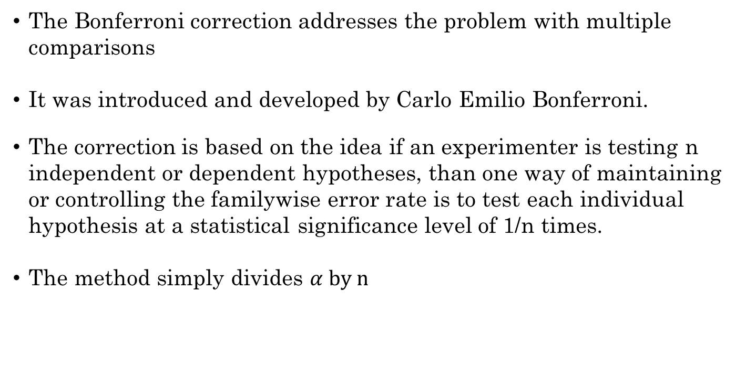
What is the Bonferroni Correction?
The Bonferroni correction addresses the problem with multiple comparisons
It was introduced and developed by Carlo Emilio Bonferroni.
The correction is based on the idea if an experimenter is testing n independent or dependent hypotheses, than one way of maintaining or controlling the familywise error rate is to test each individual hypothesis at a statistical significance level of 1/n times.
The method simply divides $α by n$

Slide 5
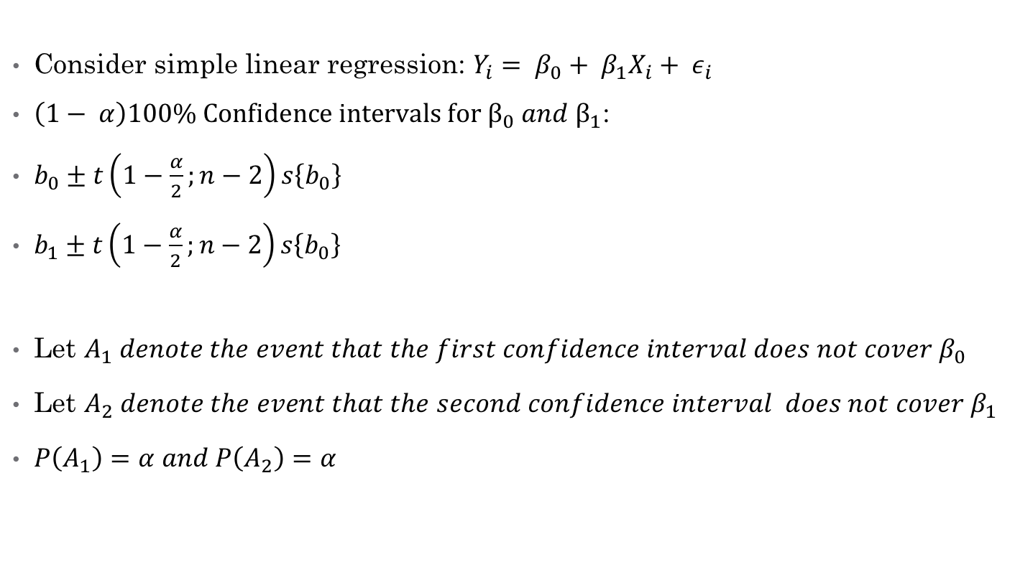
Bonferroni Inequality
Consider simple linear regression: $Y_{i}= β_{0}+ β_{1}X_{i}+ ε_{i}$
$\left(1− α\right)100\% Confidence intervals for β_{0} and β_{1}$:
$b_{0}±t\left(1−\frac{α}{2};n−2\right)s\left\{b_{0}\right\}$
$b_{1}±t\left(1−\frac{α}{2};n−2\right)s\left\{b_{0}\right\}$
Let $A_{1} denote the event that the first confidence interval does not cover β_{0}$
$\text{Let} A_{2} denote the event that the second confidence interval does not cover β_{1}$
$P\left(A_{1}\right)=α and P\left(A_{2}\right)=α$

Slide 6
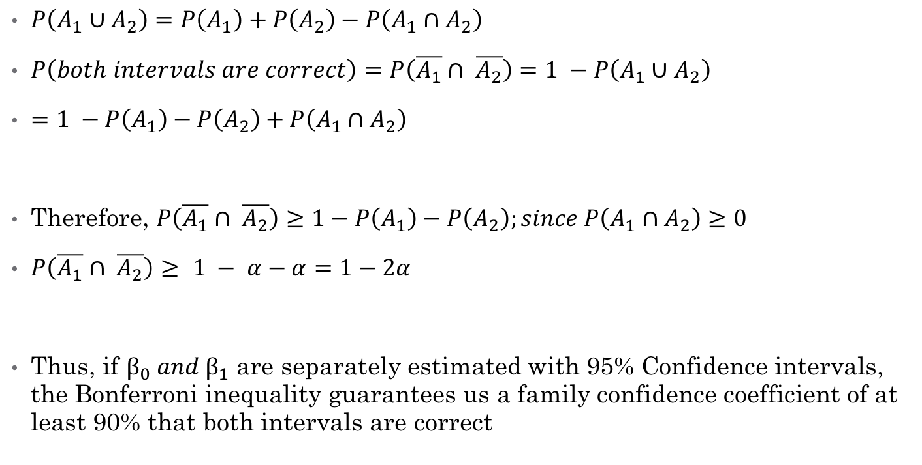
Bonferroni Inequality (Continued)
$P\left(A_{1}∪A_{2}\right)=P\left(A_{1}\right)+P\left(A_{2}\right)−P\left(A_{1}∩A_{2}\right)$
$P\left(both intervals are correct\right)=P\left(\overline{A_{1}}∩ \overline{A_{2}}\right)=1 −P\left(A_{1}∪A_{2}\right)$
$=1 −P\left(A_{1}\right)−P\left(A_{2}\right)+P\left(A_{1}∩A_{2}\right)$
Therefore, $P\left(\overline{A_{1}}∩ \overline{A_{2}}\right)≥1−P\left(A_{1}\right)−P\left(A_{2}\right);since P\left(A_{1}∩A_{2}\right)≥0$
$P\left(\overline{A_{1}}∩ \overline{A_{2}}\right)≥$ $1 − α−α=1−2α$
Thus, if $β_{0} and β_{1}$ are separately estimated with 95% Confidence intervals, the Bonferroni inequality guarantees us a family confidence coefficient of at least 90% that both intervals are correct

Slide 7
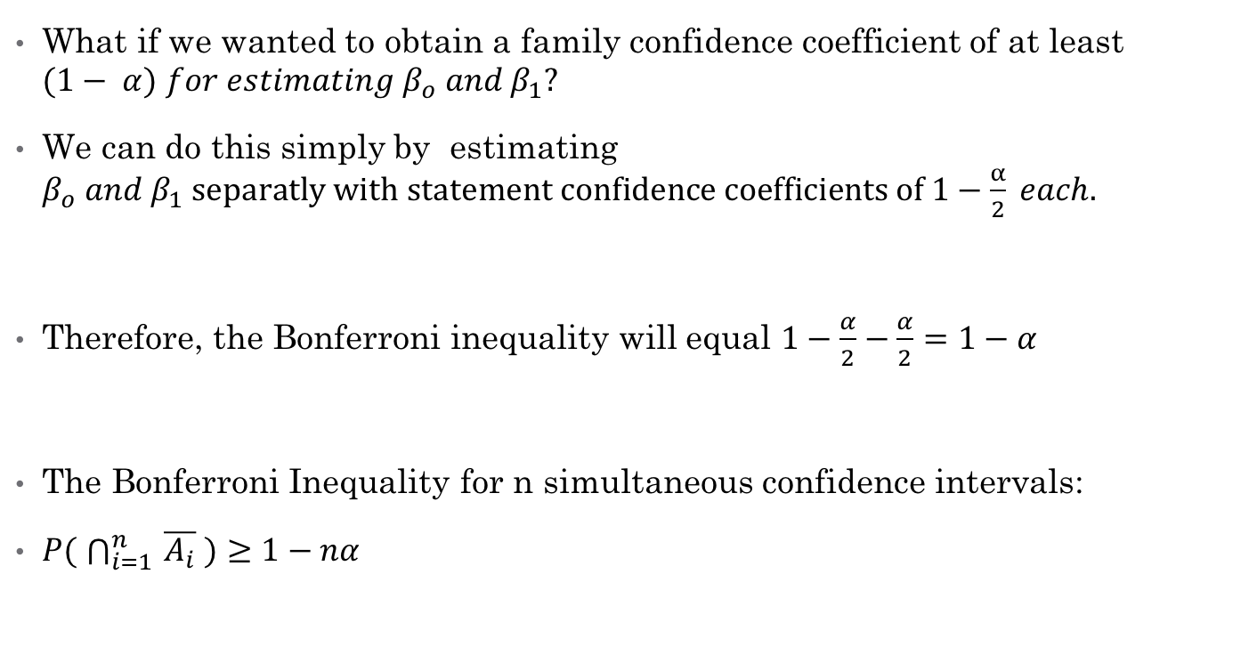
Bonferroni Inequality (Continued)
What if we wanted to obtain a family confidence coefficient of at least $(1− α) for estimating β_{o} and β_{1}?$
We can do this simply by estimating $β_{o} and β_{1} separatly with statement confidence coefficients of 1−\frac{α}{2} each.$
Therefore, the Bonferroni inequality will equal $1−\frac{α}{2}−\frac{α}{2}=1−α$
The Bonferroni Inequality for n simultaneous confidence intervals:
$P( \bigcap_{i=1 }^{n}{\overline{A_{i}} )≥1−nα}$

Slide 8
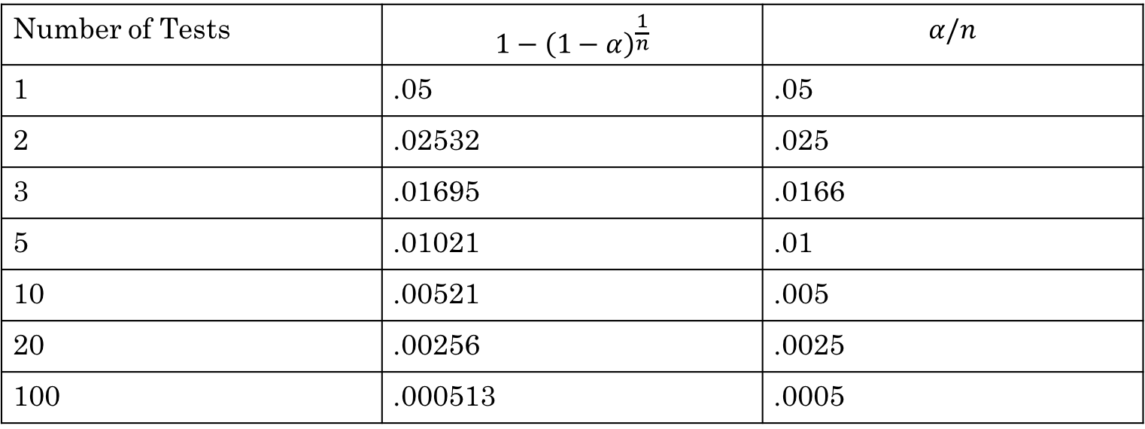
Comparison of two formula
Number of Tests | $$1−{\left(1−α\right)}^{\frac{1}{n}}$$ | $$α/n$$
1 | .05 | .05
2 | .02532 | .025
3 | .01695 | .0166
5 | .01021 | .01
10 | .00521 | .005
20 | .00256 | .0025
100 | .000513 | .0005

Slide 9
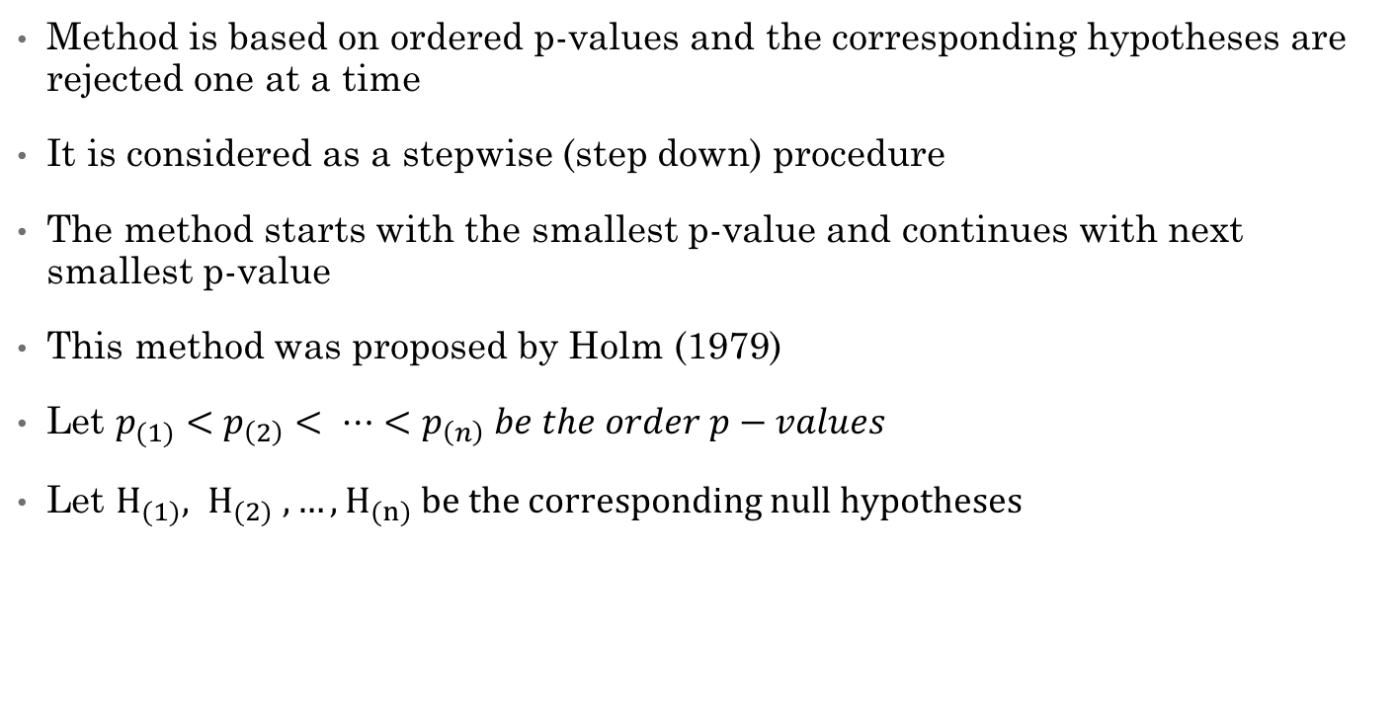
Holm Bonferroni (HB) Method
Method is based on ordered p-values and the corresponding hypotheses are rejected one at a time
It is considered as a stepwise (step down) procedure
The method starts with the smallest p-value and continues with next smallest p-value
This method was proposed by Holm (1979)
Let $p_{(1)}<p_{\left(2\right)}< ⋯<p_{\left(n\right)} be the order p−values$
Let $H_{(1)}, H_{(2)} , …, H_{(n)} be the corresponding null hypotheses$

Slide 10
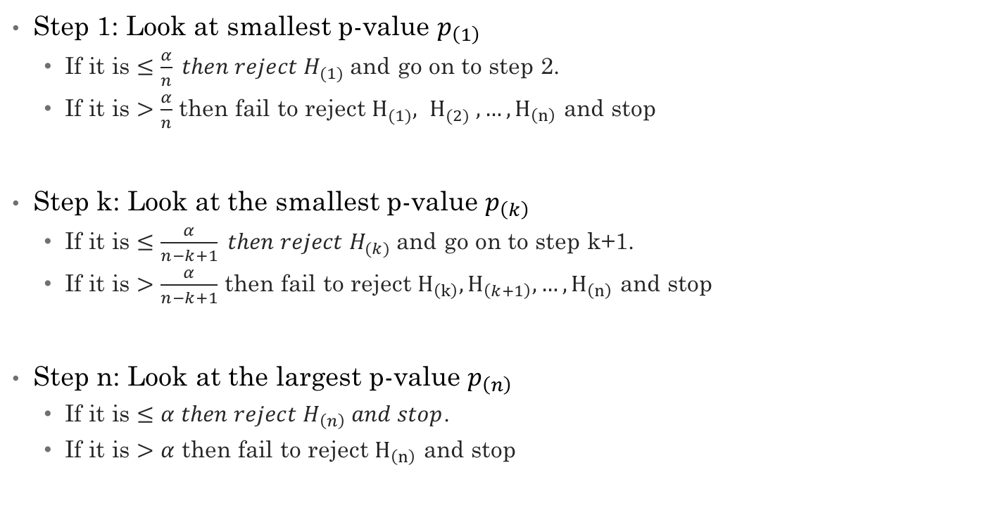
Steps for HB Method
Step 1: Look at smallest p-value $p_{\left(1\right)}$
If it is $≤\frac{α}{n} then reject H_{(1)}$and go on to step 2.
If it is $>\frac{α}{n}$ then fail to reject $H_{(1)}, H_{(2)} , …, H_{\left(n\right)}$ and stop
Step k: Look at the smallest p-value $p_{\left(k\right)}$
If it is $≤\frac{α}{n−k+1} then reject H_{(k)}$and go on to step k+1.
If it is $>\frac{α}{n−k+1}$ then fail to reject $H_{\left(k\right)},H_{\left(k+1\right)}, …, H_{\left(n\right)}$ and stop
Step n: Look at the largest p-value $p_{\left(n\right)}$
If it is $≤α then reject H_{\left(n\right)} and stop$.
If it is $>α$ then fail to reject $H_{\left(n\right)}$ and stop

Slide 11
References
Abdi, Hervé. "Holm’s sequential Bonferroni procedure." Encyclopedia of research design 1.8 (2010): 1-8.
Aickin, M., and H. Gensler. "Adjusting for Multiple Testing When Reporting Research Results: The Bonferroni vs Holm Methods." American Journal of Public Health 86.5 (1996): 726-28. Web.
Armstrong RA. When to use the Bonferroni correction. Ophthalmic Physiol Opt 2014; 34: 502–508. doi: 10.1111/opo.12131
Kutner, Michael H., Chris Nachtsheim, and John Neter. "Chapter 4, Section 4.1."Applied Linear Regression Models. N.p.: McGraw-Hill, 2008. N. pag. Print.

